Slide 1
To attack, or not to attack...
… that is the question.
Group Project by Jeremias Lenzi & Ramazan Maliqi
-----------------------------------------
Smart Contracts and Decentralized Blockchain Applications
University of Basel, Prof. Dr. Fabian Schär, 10. December 2019

Slide 2





situation
A big jackpot is sitting around on the blockchain
We’re somewhat poor students and want to get it!
Coordination among attackers needed to succeed
There is COSTS associated with the attack. Poor students!
We do not know how many attackers are sufficient
COOL!
NOT COOL!

Slide 3
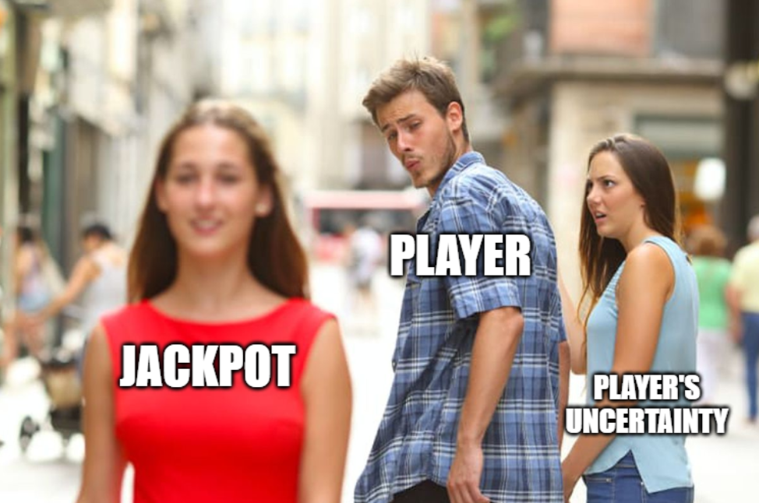
Situation summarised

Slide 4
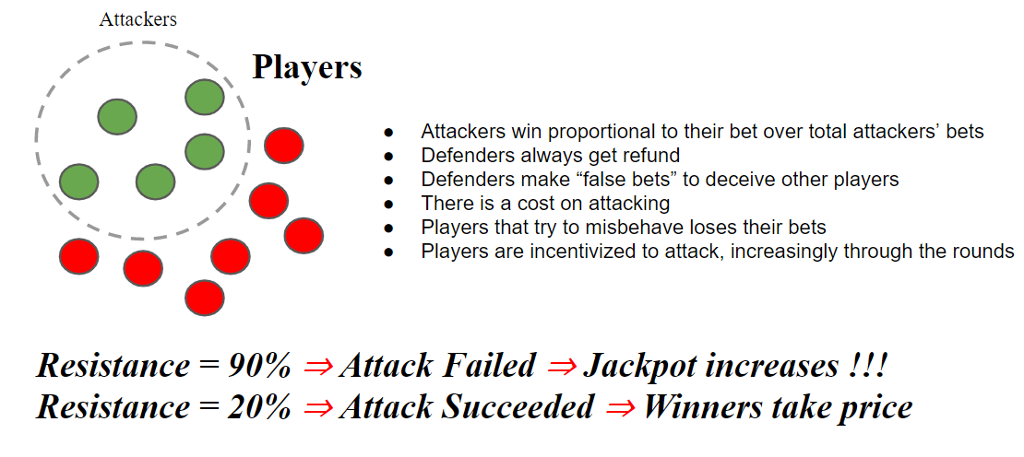
Intuition of the game

Slide 5
A bit of Theory: Commit-reveal
1. Step
Keccak256-hash
Commit = Hash gets stored
Commit is linked to player and private
31password
3 = player’s bet in ETH (has to be an uint between 1 and 9)
1 = player’s decision to attack (0 if no attack intended)
password = player’s personal password (e.g. wewillwin)
2. Step
Plain text («31password»)
Reveal = do they really match
Player’s decision is public
https://emn178.github.io/online-tools/keccak_256.html

Slide 6
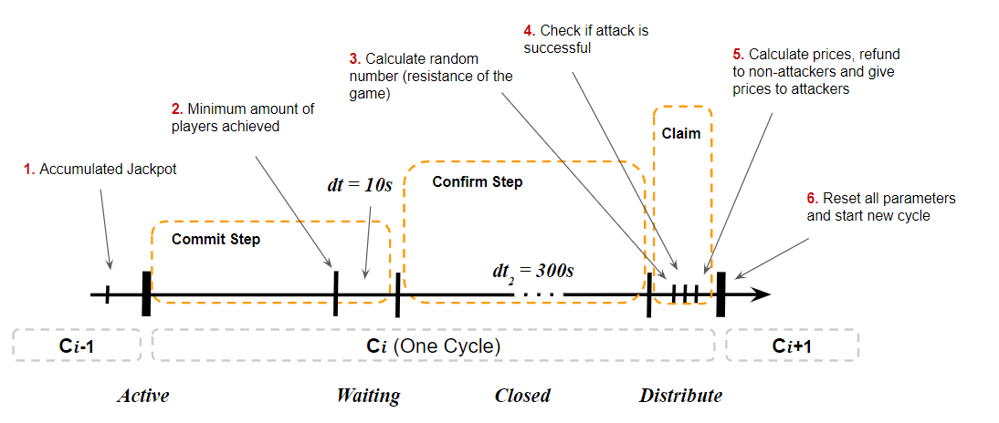
Timeline of the game

Slide 7
How does it work on the blockchain?
Let’s gamble on Rinkeby testnet!

Slide 8
Thank you

